Slide 1
“The Law”
(part 3)
Notes:
Influenced by the thoughts expressed by Alexander Campbell in his famous sermon on the Law.

Slide 2
Previously…
No divisions of the law were understood by the apostles(e.g., moral law, ceremonial law, judicial law)
  Unless a qualifier or contextual restraint exists, “law” refers to the law of Moses and/or the rule of the whole Old Testament
What the Law could not do
  Could not give life/righteousness
  Could not exhibit the full demerit and malignity of sin
  Was not a suitable rule of life for all mankind

Slide 3
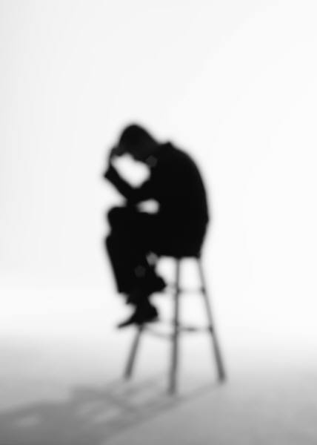
Why Could The Law Not Accomplish Life/Righteousness?
SECTION 1

Slide 4
Romans 2:12-15
12 For as many as have sinned without law will also perish without law, and as many as have sinned in the law will be judged by the law
13 (for not the hearers of the law are just in the sight of God, but the doers of the law will be justified;
14 for when Gentiles, who do not have the law, by nature do the things in the law, these, although not having the law, are a law to themselves,
15 who show the work of the law written in their hearts, their conscience also bearing witness, and between themselves their thoughts accusing or else excusing them)

Slide 5
Gentiles could sin without the law (Rom. 2:12)
  Though not given “the law of Moses,” they had “law” and requirements handed down from Adam/Noah
Jews sinned in the law (2:12)
Whether without the law (Gentiles), or with the law (Jews), people still sinned!
  Once violated, law cannot deliver one!
  Hence, God displayed that the Jew with his law is in the same predicament as the Gentile without the law—all are under sin and in need of grace (3:9, 10)!
The doers of the law are justified (2:13), yet the law condemns all under it; none are just because no one kept it perfectly (3:20, 23)

Slide 6
Perfect Works or Cursed!
10 For as many as are of the works of the law are under the curse; for it is written, "Cursed is everyone who does not continue in all things which are written in the book of the law, to do them."
11 But that no one is justified by the law in the sight of God is evident, for "the just shall live by faith."
-GALATIANS 3
Notes:
Whereby faith the just live, those under the law are cursed.

Slide 7
Why The Law Could Not Accomplish Righteousness?
Because the law gives the knowledge of sin (Rom. 3:20; 7:7)
  It does not forgive; it brings to light our trespasses
Because the law was weak through the flesh (Rom. 8:3)
  The Law’s purpose was perfect, but…
    It was too excellent for man’s weakness to keep perfectly (Rom. 7:18, 19)
    The law wanted perfection, but the most noble characters under the law were still stricken with sin (presumption, polygamy, lust, etc.)
Notes:
Law—knowledge of sin. The purpose of the law is to shed light on sin, not justify us from sin. You know we have an unwritten code that man has created which has often been repeated, “You can look, but just don’t touch.” Many people believe in that. This would certainly not condemn the covetous person who looks and lusts, but doesn’t touch. Yet when we read in the law condemnation against the covetous, we then reflect on the times we violated that law. We stand condemned not justified by the law. It is like driving down the road at 70 mph and thinking that such was permissible. But then we see a sign that says 60 mph. The law doesn’t justify, but condemns. It doesn’t reward, but seeks to stifle inappropriate behavior.

Slide 8
Why The Law Could Not Accomplish Righteousness?
Because the offerings of the law were too beggarly to forgive the debt of the transgression (Heb. 10:4)
  The system of law cannot produce a real provision for true forgiveness because there is no true redemption (Gal. 2:21)
Because only God can forgive sin (Prov. 20:9)
  Law does not forgive, God does (Ex. 34:6, 7; Acts 13:38, 39; Ps. 32:5; 103:2-4; Is. 1:18; 43:25; Mic. 7:19; Rom. 8:33; Lk. 5:20, 21; Eph. 1:7)
Notes:
These passages provide beautiful insight into the gracious forgiving nature of God if we would but acknowledge them, repent of them and turn to God. There is a place of quite of quiet rest near to the heart of God. There is a place where sin can be forgiven and refreshing is. Sin and its guilt wears down. It breaks us apart. It tears at our mind. It brings forth depression. It wounds and robs us of joy and energy. But in forgiveness and full pardon our strength can be renewed (Ps. 103:2-5).
Is. 43:25
1. Action: “blots” that is cancels the debt against us.
2. Motive: “For My own sake.” God is just and the justifier. He forgives to show his character before men (1 Tim. 1:15, 16). Further, He forgives that we might honor His name, fully hate the crimes we have done and live for Him. He forgives that godliness may abound. He does not forgive that we might sin all the more. He does not forgive that we might take for granted salvation, but that we might fully and truly live for Him, seek His ways and bring honor to His name (Ezek. 36:16-28). Hence we should appreciate that none can forgive but God alone. The papacy has blatantly forgotten this simply fact. No mortal priest has the power to forgive sin because no mortal has the ability to pay for the crime.
3. Completeness: In being seen that he remembers them no more or casts such crimes behind His back (Is. 38:17).

Slide 9
The Allegory of Hagar and Sarah (Gal. 4:21-31)
SECTION 2
Notes:
Allegory – in English is a story where people, places, things and occurrences have another meaning. I love reading material that is allegoric. Paul take our minds and places us in the happenings of 2000 years before Christ coming and reveals other meanings that played out in the lives of Abraham’s two wives, Hagar and Sarah and their children.

Slide 10
The Allegory of Hagar and Sarah
GALATIANS 4:21-31
Hagar (the bondwoman)
Sarah (the free woman)
Ishmael (child of the flesh par. phys. Jew.)
First Covenant (Law) tied to Mount Sinai
→ earthly Jerusalem
→ bondage
This law leaves all her children in bondage (cf. Gal. 2:16)
Persecuted the child of promise (4:29; Gen. 21:9)
Isaac (child of pro., accord-ing to the Spirit, “we” v. 28)
Second Covenant (gospel)
→ Jerusalem above → free
We are not children of the bondwoman (Sinai Law) but of the freewoman (New Cov.)
Even so they now persecute

Slide 11
Galatians 4:21-31
The Allegory of Hagar and Sarah
Hagar (the bondwoman)
Sarah (the free woman)
"Cast out the bondwoman and her son, for the son of the bondwoman shall not be heir with the son of the freewoman" (Gal. 4:30)
  Lesson against being under two covenants (Gal. 4:21, 24, 31; Heb. 10:9; Rom. 7:1-4)
  Lesson re: fellowship –Rom. 16:17, 18;
  2 Jn. 9-11; 2 Thess. 3:6; etc.)

Slide 12
In The Next Lesson:
Defects of the Law
No life and righteousness
No full exhibit of the malignity of sin
Not a suitable rule for all mankind
HOW GOD REMEDIED
the defects of the law

Slide 13

Will you become a child of the freewoman?
  Will you look into and obey the “perfect law of liberty” (Jas. 1:25)
  Will you obey Jesus your savior today so that you can join in with the chorus of Isaiah 54:1?
    Hear Him (Lk. 19:47, 48)
    Believe Him (Jn. 8:24)
    Obey Him through repentance, confession and baptism (Acts 2:38; 8:36, 37)!

